Slide 1

D28 special education committee meeting may 13, 2025
Mrs. Stacy Palmer
Administrator of Special Education, D28

Slide 2

Special Education Continuum
Kindergarten Intake Process (KIP)
K-8 School-aged Services
Office for People with Developmental Disabilities (OPWDD)
Other Family Guides / Resources / Agency Linkages
Questions

Slide 3

Special education continuum

Slide 4
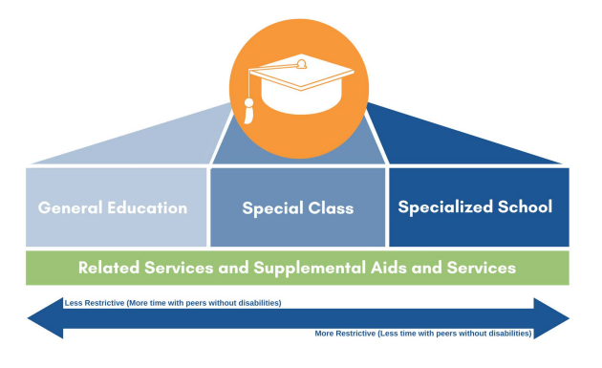
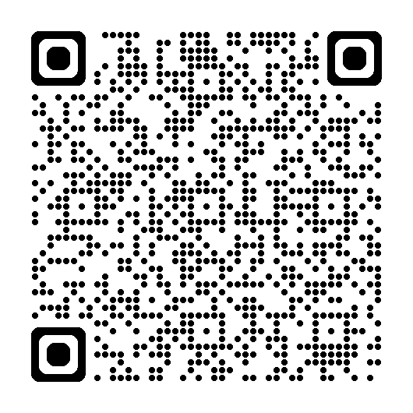
Continuum of se services
Notes:
Special education is a service, not a place.
IEP team decisions about programs and services must be based on the individual needs of each student
Regardless of setting and program recommendation, to promote student access, engagement and independence, supplementary aids and services, accommodations and assistive technology should be considered and implemented based on student needs

Slide 5
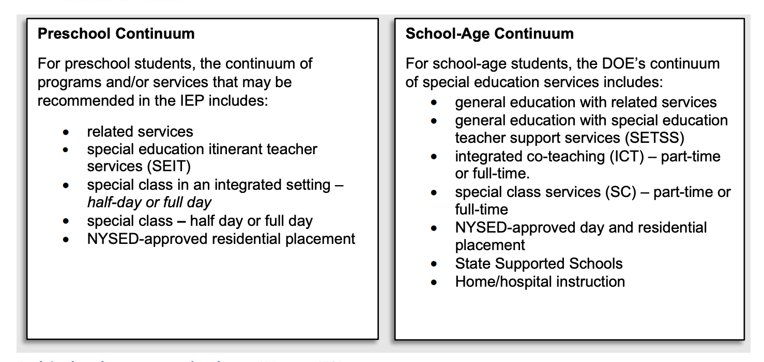
Special education continuum

Slide 6
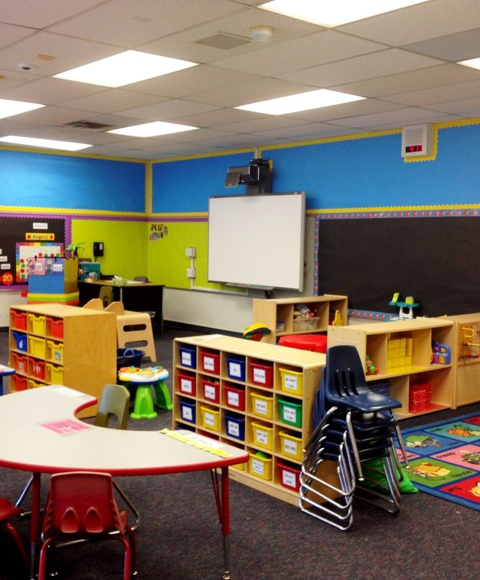
kindergarten intake process (KIP)
** Formerly known as Turning 5 (T5)

Slide 7

Kindergarten students
Families of children with disabilities entering kindergarten in September will take part in two processes. They are:
the Kindergarten IEP Process (KIP), which is how special education services and supports are determined for children entering kindergarten.
Every elementary school is expected to welcome and serve students with disabilities in accordance with their Individualized Education Programs (IEPs). Families of students with disabilities entering Kindergarten in the fall are encouraged to participate in kindergarten admissions in addition to the Kindergarten IEP Process (KIP). For information about the Kindergarten IEP Process for these children, visit schools.nyc.gov/KindergartenSpecialEducation(Open external link)
Special Education for Children Entering Kindergarten
New York City Public Schools (NYCPS) will work with you to consider whether your child needs special education in Kindergarten, and if so, develop an Individualized Education Program (IEP). This is called the “Kindergarten IEP Process” or “KIP,” and your participation is important.

Slide 8

The KIP reevaluation
The KIP reevaluation is an opportunity to review anticipated progress, pre-academic and academic achievement as well as functional progress, and to determine whether the student meets the special education eligibility criteria for school age services. If necessary to determine eligibility, assessments may be conducted. Best practice preparations for a KIP IEP meeting may include the following:
  A review of CPSE assessments
  A review of all progress reports (including any from private practitioners, if applicable)
  A social history update
  An updated physical assessment
  An observation, if applicable
  A comprehensive understanding of the student's mastery of, and/or progress toward, age-level goals
  A review of information gleaned from the student's teacher(s) and/or provider(s)

Slide 9
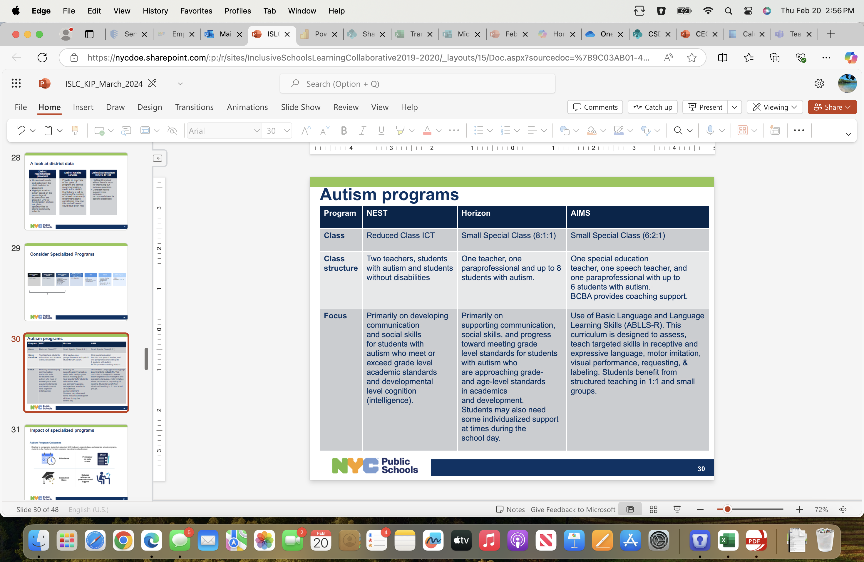
Autism program considerations

Slide 10

District 75
District 75 provides highly specialized instructional support for students with significant challenges, such as:
  Autism Spectrum Disorders
  Significant cognitive delays
  Emotional disabilities
  Sensory impairments
  Multiple disabilities
District 75 provides instructional support in a wide variety of settings and locations around NYC, including:
  Special classes co-located in District 1-32 schools
  School building where all students have IEPs
  General education classrooms
  Agencies, hospitals and at home
The IEP team, of which you are a member, will recommend the appropriate program and class size for your child. This determination is based on cognitive, social-emotional and physical management needs.

Slide 11

School-aged services

Slide 12
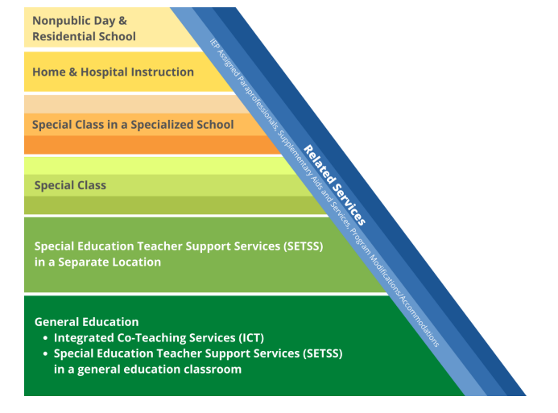
Service placements
There are many service delivery options available within the programs and settings listed, and that any service or program can be provided for just some of the day.
The goal is to support students in meeting their vocational, career, and/or other community-based postsecondary goals by fostering independence, self-direction, and full participation in each student’s least restrictive environment.

Slide 13

Other special education services
Accommodations and Modifications
Accessible Education Materials
Adaptive Equipment
Adapted Physical Education
Alternate Assessment
Declassification Services
Extended School Year Services (ESY)
Paraprofessional Services
Travel Training
Notes:
Accommodations: Tools and procedures that give students with disabilities equal access to instruction and assessment. Presentation / Response / TIming, Scheduling / Setting
Modifications: Modifications change the content and/or the instructional level of the curriculum. Modifications are made for students with disabilities who are unable to understand the content an instructor is teaching
Accessible Education Materials: Accessible Education Materials (AEM) are textbooks and instructional materials that have been converted into a format that is accessible to a student who is unable to use standard printed materials. Braille, large print, audio, digital text
Adaptive Equipment: Devices used to assist students with: Daily living activities, Participation in the school environment. Physical and occupational therapists work with students to determine if these devices are needed. Some examples of adaptive equipment are: Standers, gait trainers, adaptive chairs, feeding or toileting equipment
Adapted Physical Education: Team will recommend APE if your child cannot safely or successfully participate in the regular physical education program. APE teaches will adapt and modify a physical activity so that is is appropriate for student. developmental activities, games, sports,
Alternate Assessment: Used to evaluate the performance and progress of students who are unable to take part in standard assessments, even with testing accommodations
Declassification Services: Students who no longer need special education services are declassified after a reevaluation.
Extended School Year Services (ESY): Extended School Year (ESY) services are different from general education summer school. These services are recommended for students with disabilities who require special education over the summer to prevent substantial regression.
Paraprofessional Services: A paraprofessional is an aide who provides assistance to students. It may be to an entire class or to an individual student. It can be for all, or part, of a school day. (Behavior support, Health, Transportation, Orientation and Mobility, Toileting, Awaiting Placement/Language)
Travel Training (eligible students age 14 and above)

Slide 14
Transitioning between grade bands
Students with Individualized Education Programs (IEPs) in district schools participate in the same admissions process as their non-disabled peers.
The expectations and schedule in one grade level may be different from what your child experienced in another grade band. Work with your child's IEP team to determine which supports and services your child will need in their new school. Some things you may want to discuss are:
  Special education program options (for example: whether or not your child will need full- or part-time support from a special education teacher and in what subject areas)
  Opportunities to be in class with non-disabled peers
  Related service duration, frequency, and location
  Testing accommodations
  Post-secondary goals and transition planning

Slide 15
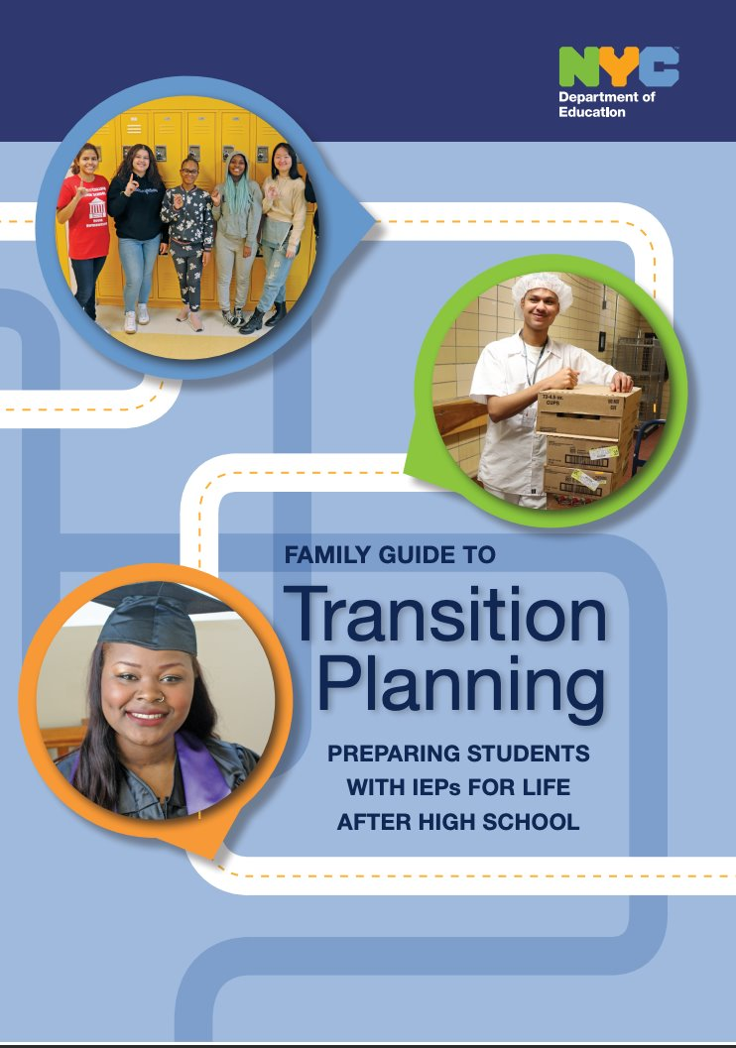
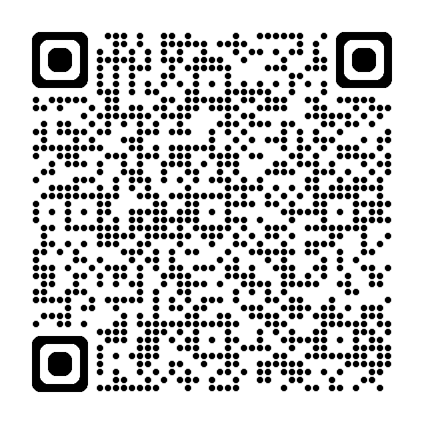
Transition planning
The formal process of transition planning begins in the year which your child turns 12 (or earlier if appropriate).
The transition planning process is driven by the goals, desires, and abilities of your child.
A vocational assessment must be completed during the calendar year in which the student turns 12 years of age.
Starting when your child is 14years old, the IEP team will begin considering your child's goals for life after high school. These are called measurable postsecondary goals. At the same time the team will consider a coordinated set of transition activities that will support your child to in meeting these postsecondary goals

Slide 16
Extended school year (esy)
Your child’s IEP may recommend Extended School Year (ESY) services (also known as “12-month services”). ESY services are:
  special education instructional programs and/or related services provided during July and August
  different from general education summer school
The IEP team recommended either they receive the same program and services in July–August as in September–June, or less intense services, according to their individual needs
Students with 12-month Special Class recommendations participate in our Extended School Year (ESY) program. This program offers:
  a full day of learning designed to help students reach their IEP goals
  incorporates enrichment activities to offer students a fun and rewarding summer experience
  If your child also has SETSS or Related Service recommendations in addition to Special Class, they will also get those services as part of their program
The ESY program is different than general education summer programs that are not designed to provide special class or provide IEP prescribed supports for students. If your child’s IEP recommends 12-month related services and/or Special Education Teacher Support Services (SETSS) they may attend Summer Rising (on the same basis as students not recommended for ESY), in addition to receiving his/her recommended related services and/or SETSS
The ESY program will run Monday through Friday, beginning on July 2 and ending on August 12

Slide 17





Slide 18

OPWDD
Provides services to New Yorkers with Developmental Disabilities including Intellectual Disabilities, Cerebral Palsy, Autism Spectrum Disorders, Down Syndrome and other neurological impairments
Helps individuals with Developmental Disabilities live in the home of their choice, find employment, make meaningful community connections and engage in activities of their choice

Slide 19

OPWDD services
Services include:
Medicaid funded long term care services (habilitation, clinical services, residential services)
Family support services (providing care for a disabled loved one)
Employment support services (job coaching, job matching, vocational training)

Slide 20
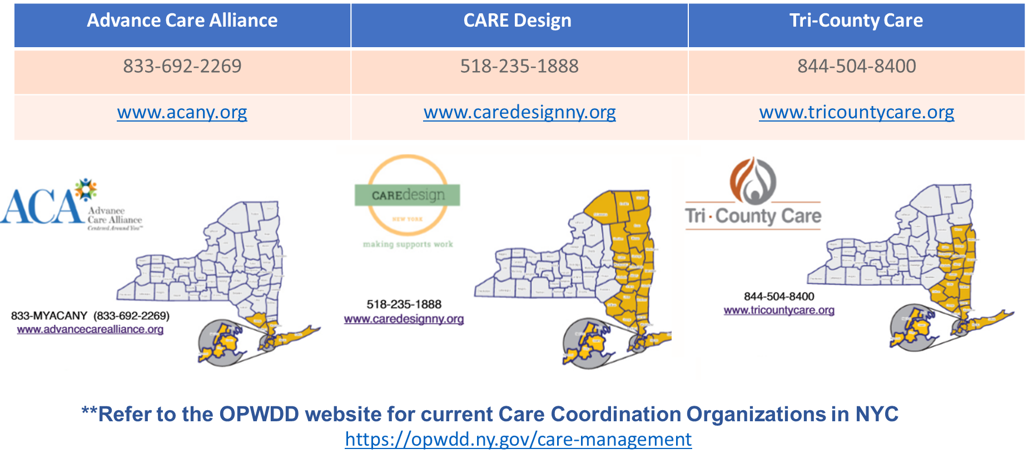
Care Coordinator organizations in NYC

Slide 21

OPWDD Day services
Each service is focused on giving participants the personal, social and vocational supports needed to live in their community
Community Habilitation Services: Provided to individuals who do not reside in a residence which is certified or operated by OPWDD (including one’s home)

Slide 22

Opwdd day services
Day Habilitation Services: provided to an individual regardless of his or her living environment, and regularly take place in a non-residential setting, separate from the individual’s private residence or other home
Prevocational Services: addresses the individual’s vocational interests. They assist individuals who are interested in joining "the world of work" but whose skills are such that they may not expect to obtain competitive employment within the next year

Slide 23
Self-direction (OPWDD)
Self-direction gives the person receiving services the chance to choose your own services so you can live the life you want. By self-directing one's services, a person has more flexibility to choose the right supports for themselves, the staff they want to work with, and a schedule that works best for them
Self-direction may be right for your child if:
You want more flexibility with your child services and schedule
You are ready to make decisions about the services on your own or with help
You want to take more responsibility for managing services

Slide 24
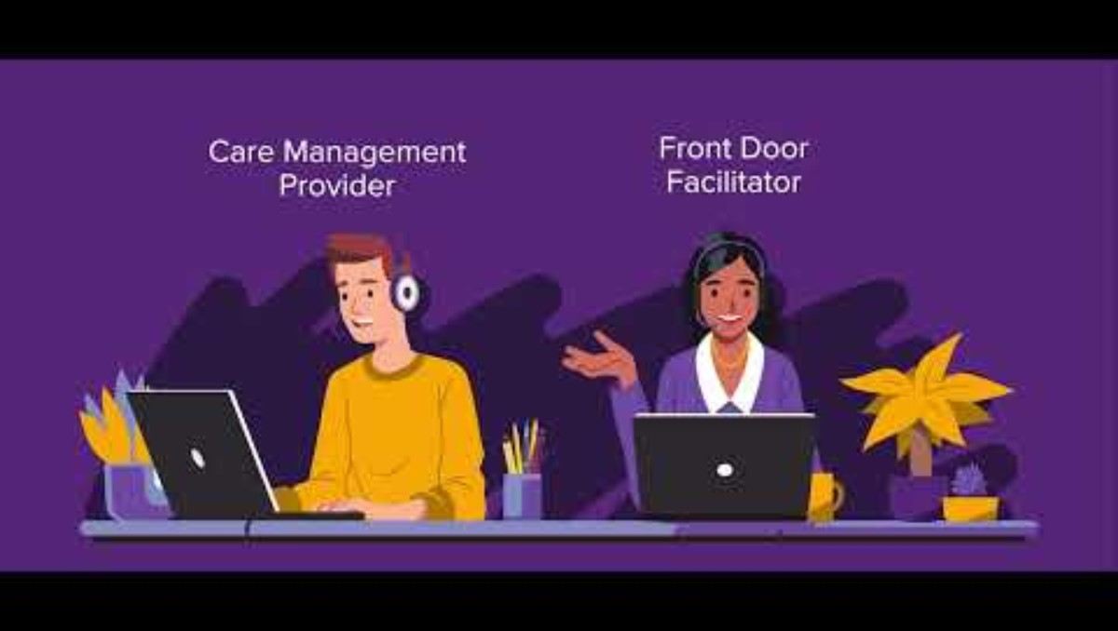
Getting started with opwdd
Notes:
Getting Started with OPWDD

Slide 25

Other opwdd videos resources
Getting Started with OPWDD
The Front Door Process
Eligibility
OPWDD Services
Residential and Housing Support
Assessment
OPWDD Care Management
Self-direction
Employment Services
Funding

Slide 26

Other family guides / resources

Slide 27
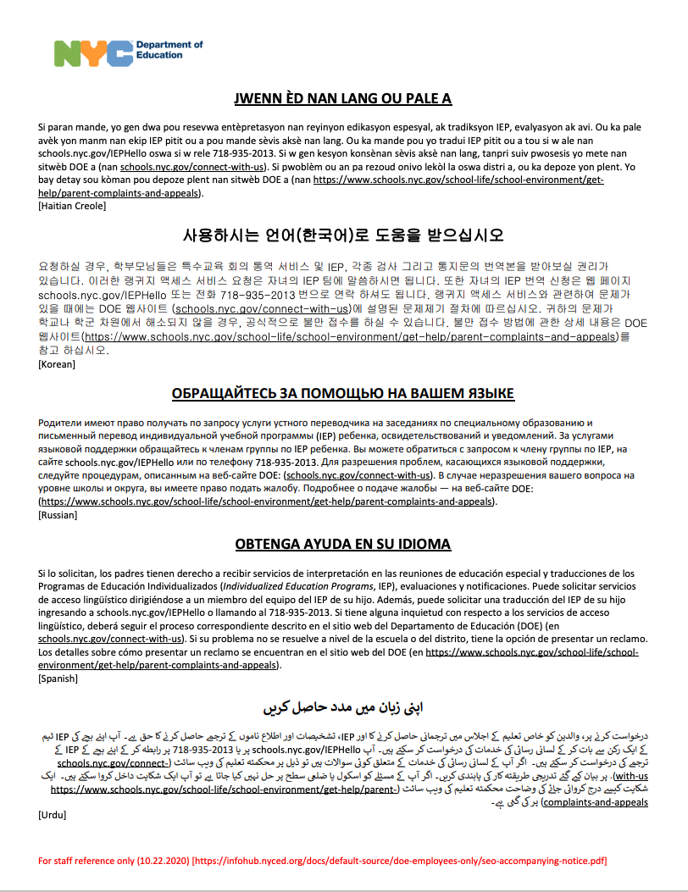

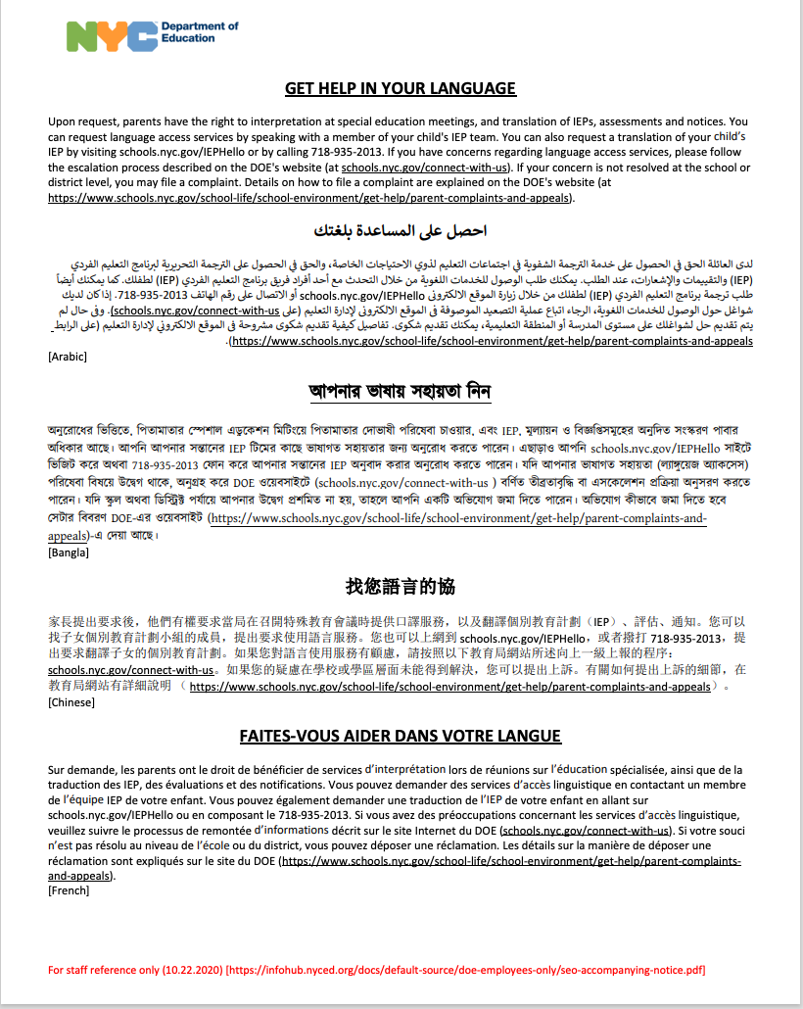
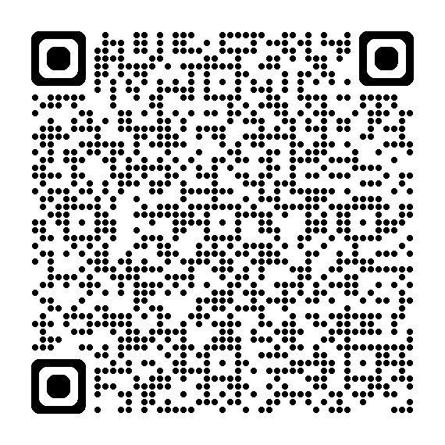
Getting help in your language

Slide 28
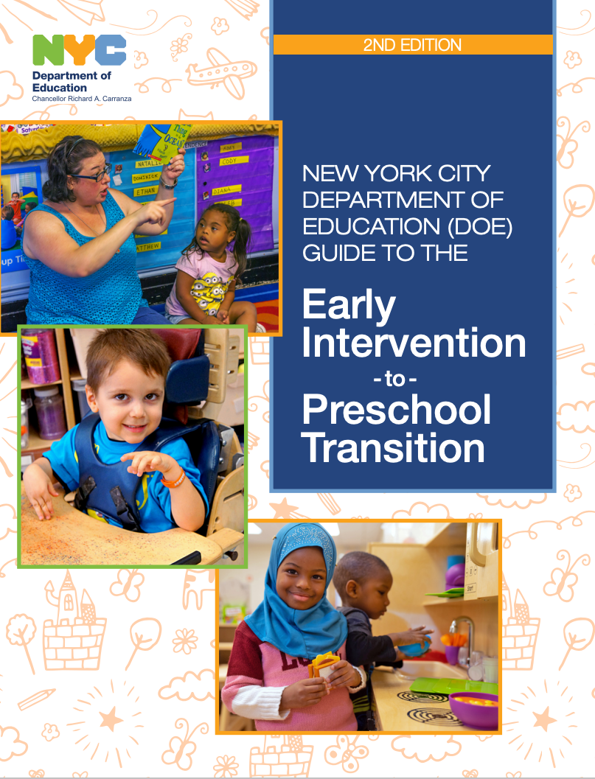
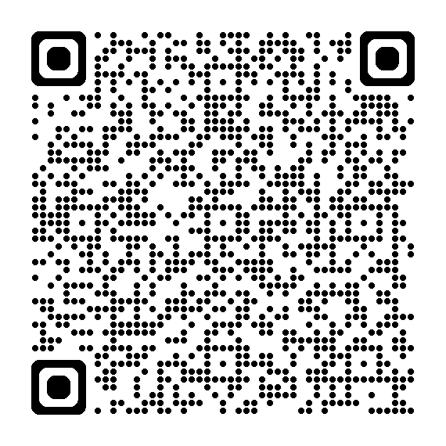
early intervention

Slide 29
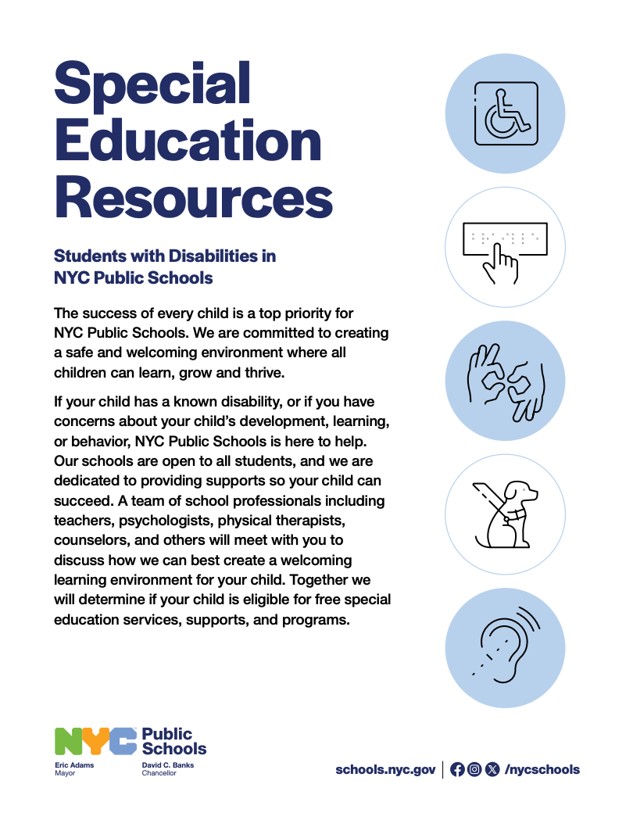
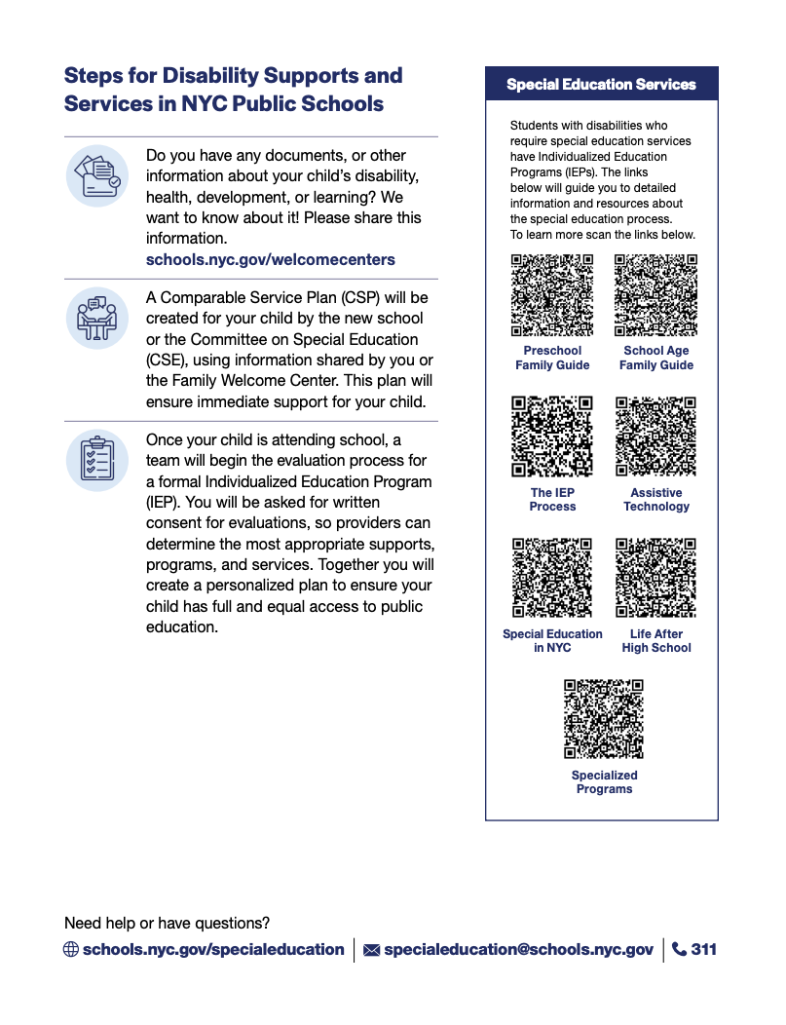
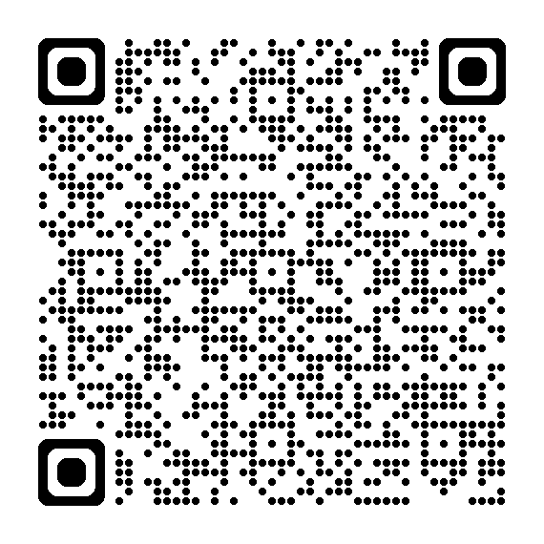
Resource for newly arrived families

Slide 30

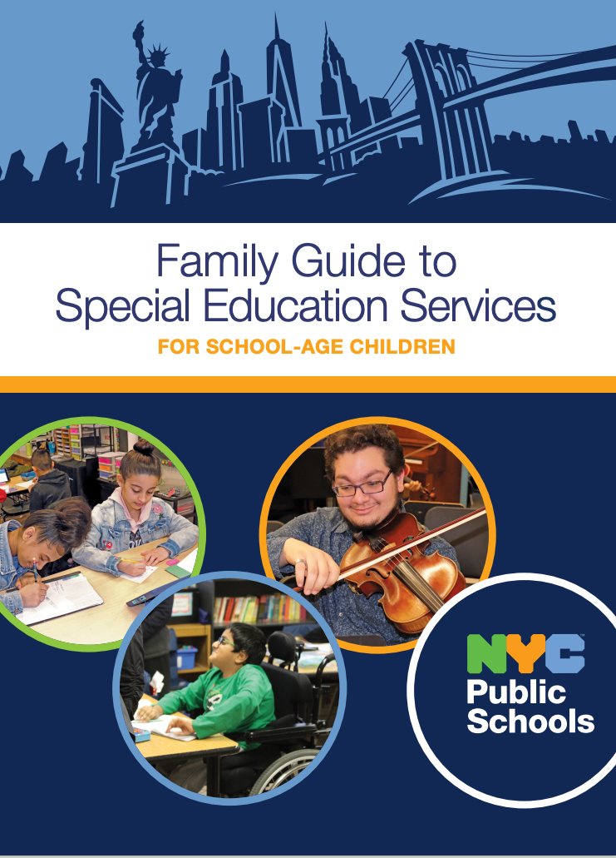
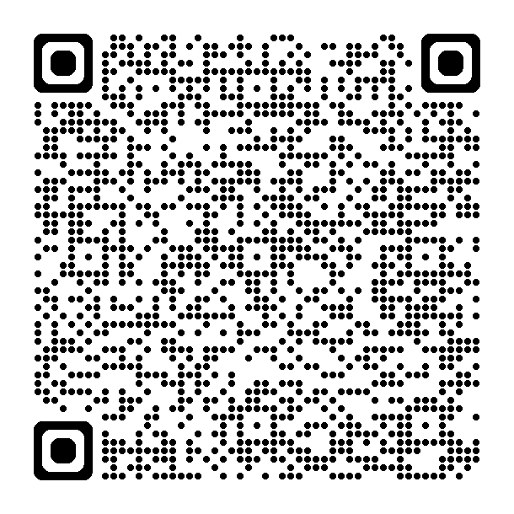
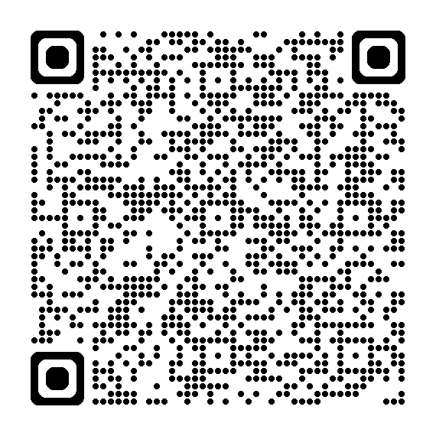
Family guides for special education services

Slide 31



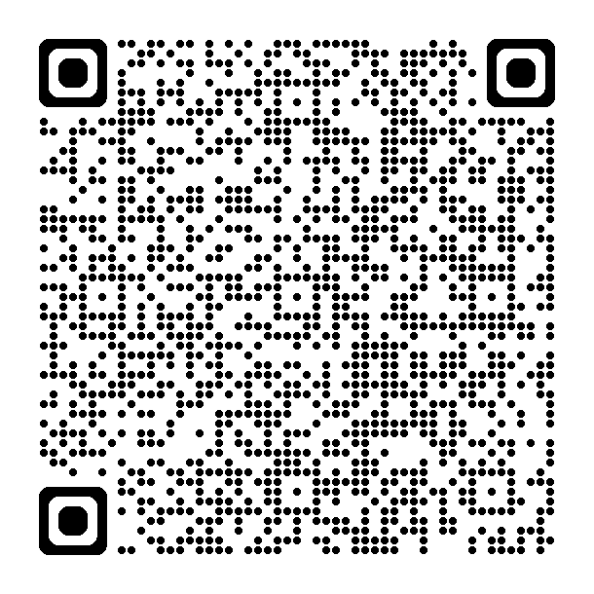
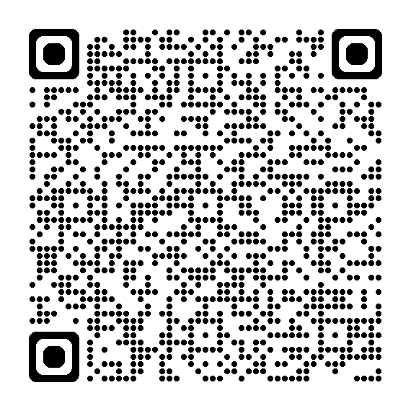
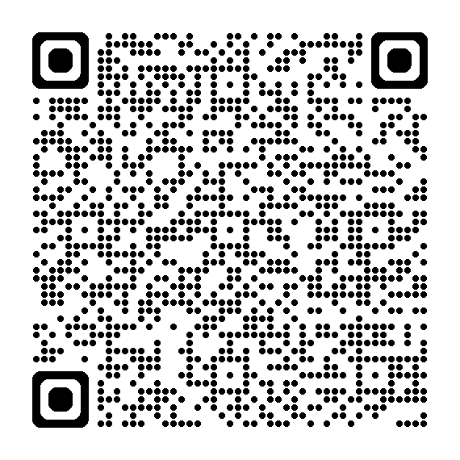
ask & Share

Slide 32

Committee of special education (CPSE / CSE)
CPSE/Preschool Inquiries
Email: CPSE3support@schools.nyc.gov(Open external link)
CSE/School Age (K-12th grade) Inquiries
General Email: CSE3@schools.nyc.gov
For private school families, Notice of Intent Submission should be emailed here: CSE3PNI@schools.nyc.gov
CPSE/CSE 3 Address
Districts 25 & 26:
30‐48 Linden Place
Flushing, New York 11354
Districts 28 & 29:
90‐27 Sutphin Boulevard
Jamaica, New York 11435

Slide 33















Agency linkages

Slide 34

AGency links
NYS Office of Mental Health
National Federation of the Blind
Birch Family Services
YAI
Office for People with Developmental Disabilities (OPWDD)
Center for Independence for the Disabled (CID-NY)
Adapt Community Network
Brooklyn Autism Center
AIM High Children Services
Challenge
IncludeNYC
My Time Inc.
Sinergia
Access VR

Slide 35
** NEW** Autism applications - online
CHILDREN ENTERING KINDERGARTEN
Online Application Form: Autism Program Application form
To complete the application in one of the DOE-supported languages, please select from the language drop down. For Haitian Creole use this link.
Families should also complete the general kindergarten admissions process. To learn more: kindergarten admissions process.
CHILDREN IN GRADE K-12
Online Application Form: Autism Program Application form
To complete the application in one of the DOE-supported languages, please select from the language drop down. For Haitian Creole use this link.
Families can apply anytime.
All assessments needed for the application process can be completed by your IEP team. You or your child’s school can send the completed application by:
Email: AutismPrograms@schools.nyc.gov

Slide 36

Questions

Slide 37

Mrs. Stacy Palmer
Administrator of Special Education
D28 K-8 Schools
Spalmer4@schools.nyc.gov

